Slide 1

Ambitious learners who are knowledgeable and literate

Slide 2


Knowledge: How Do We Learn?
Notes:
Today, We’re going to look at the cognitive Science behind how we learn and remember things, how we can apply that to revise and learn in the most effective way, how we use knowledge organisers to help us learn, and how to self quiz so that we really remember the knowledge we learn in the long term.

Slide 3
Working Memory: An Introduction
Watch the video on the next slide.
Don’t write anything down as you watch.
Just rely on your “working” memory.

Slide 4
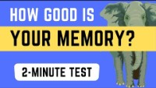

Slide 5
There are three steps to making memories:
Encoding memory
Storing memory
Retrieving memory
Notes:
Encoding memory – so that’s learning and understanding the information in the first place.
Storing memory – this is where we practice the information and think deeply about it, so that it gets stored into our long term memory
And then retrieving memory – this is where we return to the information we have learned in the past (this might have been the day before, a week before, or a term before) and we try to bring it from the back of our head to the front of our mind. This last step, retrieving the memory, is absolutely essential. If we don’t frequently practice retrieving memory, then it is as if we never learnt the information in the first place. There is NO POINT at all learning information if you can’t actually remember it later on, when you really need it.

Slide 6
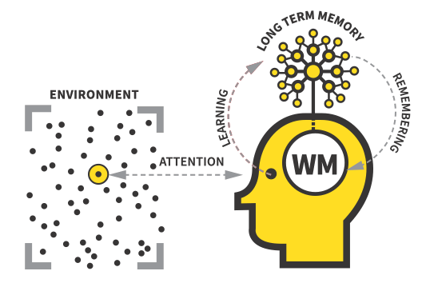
Notes:
This image shows that process in a bit more depth. Firstly there is the environment. The environment is lots of stimuli that you could potentially pay attention to. It’s important that we pay attention to the right stimulus fully, as otherwise we won’t understand or remember what we are learning. That’s why it’s so important that the whole class listens carefully without talking when a teacher is explaining something new, or why we have to be silent when focussing on something really tricky; our brains cannot process information properly when they are distracted. So, if we pay proper attention to something, which means we focus all our attention on it without distractions, then the information can go into our working memory (WM). Working memory is quite limited; it can only process 3-4 pieces of new information at a time. That’s why learning information in short chunks rather than in a big paragraph is a good idea. It’s important we don’t overload our working memory, or we don’t stand a chance at ever remembering what we learn in the future.
Once we have understood and processed new information, we need to practise using it. This might be through repetition, saying new words out loud or answering practice questions on a new concept. After we do this successfully, the information can be stored in our long term memory. That sounds like it should be the end of the process, but it isn’t. Because here’s the vital part; if we don’t then revisit the information at a later date, the “retrieving” part we talked about earlier, then the memory almost stays trapped in the back of our heads. Basically, it is useless to us; we would have spent effort understanding the new information, but we can’t ever actually remember it when we need it in an exam. The only way to avoid forgetting what you learn is by practising remembering it. That means, practising it not just once, not twice, but lots of times and over a long period of time. Coming back to the same knowledge again and again not just on that day, but in one week, then again in the next month, and so on.

Slide 7
Working memory is limited.
We can only make knowledge "stick“ in our long term memory through lots of practice over time.
Practice makes permanent.

Slide 8
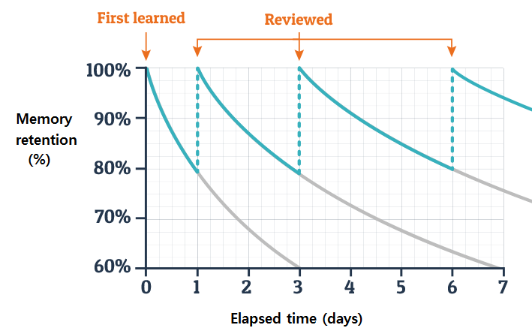
First learned
Revised
Notes:
Explain this forgetting curve in audio recording

Slide 9
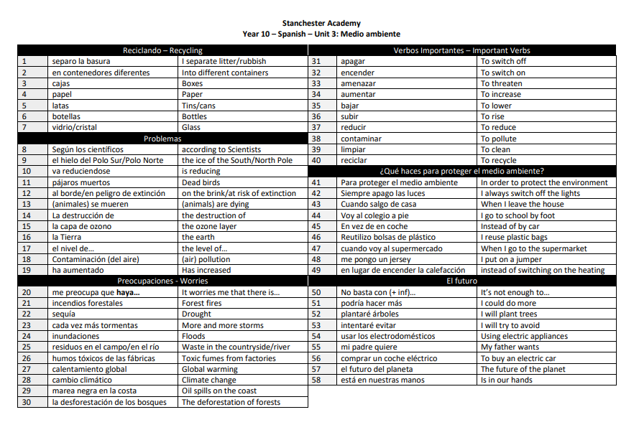
Knowledge Organisers
A4 document with all of the key knowledge you need to know fluently
Set out in a table – easier to cover.
Black and white without visual distractions – easier to focus.
Separated into clear sections
Each chunk of knowledge is numbered
Same format for every subject – cognitive load
Notes:
This is where homework and knowledge organisers come in. Our knowledge organisers have been carefully designed to help you learn and revise best. They are A4 pages with only the most essential knowledge you need to learn on. They are set out in a table – that’s because it’s easier to cover over the definitions in a table, so the “look, cover, write, check” process is much easier. They are separated into sub topics or sections, so they are easier to navigate. Each chunk of knowledge is numbered, which makes it easier and clearer when we are quizzing or setting homework. And finally, every single subject’s Knowledge Organisers look identical with hardly any pictures or colour. That is a conscious choice to limit the distractions and help you focus just on the knowledge that matters. We have worked hard to present these in a way that means you can learn and remember it the best.

Slide 10



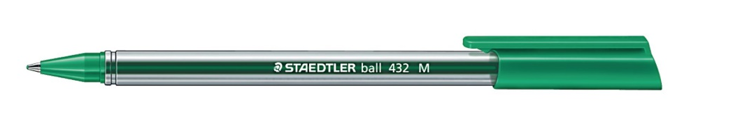
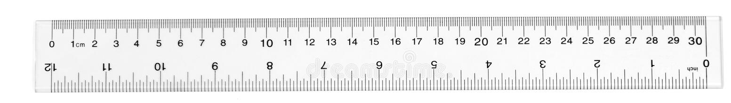
Equipment for Self-Quizzing:
Get the following in front of you
Green pen
Black or
blue pen
Knowledge organiser folder
Practice book
Ruler
Notes:
Tutors, please select two wonderful people to hand out a practice book.

Slide 11
Year 7 Student Folders
Put your timetable inside the front poly pocket.
On the reverse side of this same poly pocket, insert the map of the school.
Write your name and tutor group at the top of your Maths knowledge organisers.
Put the Maths knowledge organiser in the next poly pocket after your timetable and map.

Slide 12
Student Folders
Remove all existing Knowledge Organisers sort them into subjects.
Put your timetable inside the front poly pocket of your folder.
Put the KOs into the folder in the following order. KS3:
Maths, English, Science, Spanish, History, Geography, RE, BDS, Drama, Music, Art
KS4:
Maths, English, Science, Option A, Option B, Option C.

Slide 13
Practice Books: Front Cover
Your full name
Your tutor group
Practice Book
Notes:
Let’s set up our practice books. We will then very nearly fill in the information on the front of the book.

Slide 14
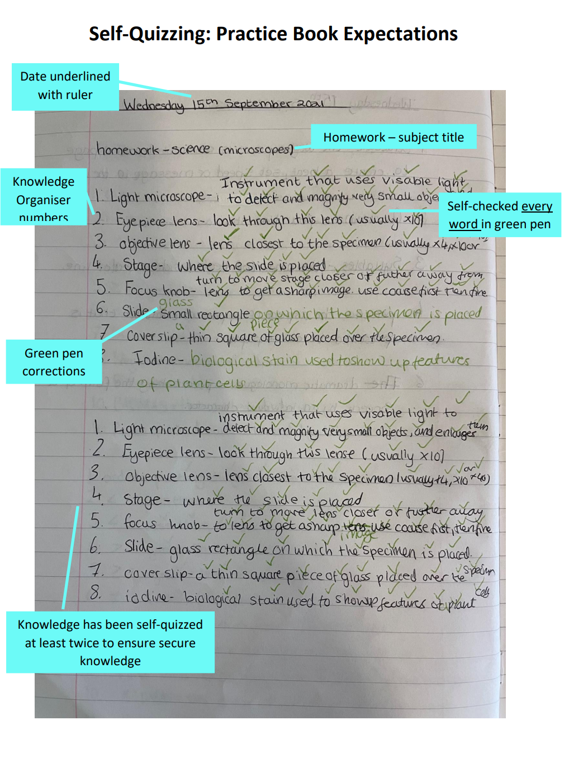
Practice Books
This poster shows the expectations of quality and presentation in your practice book.
If your home learning does meet these standards and is handed in on time, you will receive an R1 point.
If your home learning does not meet the standards shown on the poster, you will be asked to do it again.

Slide 15

Self-Quizzing Masterclass: Video
Watch 'Stanchester Academy Self Quizzing Video' | Microsoft Stream

Slide 16
Practice Time
Practice the self quizzing process as shown in the video using a knowledge organiser:
1. Make sure you have the equipment needed. Date and title neatly underlined.
2. Choose ONE chunk at a time to learn. Look and read it quietly aloud 3-4 times.
3. Cover
4. Write what you can remember
5. Check using a green pen – tick every correct word and make corrections
6. Repeat

